Slide 1
RAJESHWARI VEDACHALAM GOVT. ARTS COLLEGE DEPARTMENT OF COMPUTER APPLICATION PROJECT NAME : Optimizing Flight Booking Decisions through Machine learning Price Predictions. TEAM MEMBERS NAMES TEAM LEADER- R. Preethi K . Rithika E . Swetha S . Abirami

Slide 2
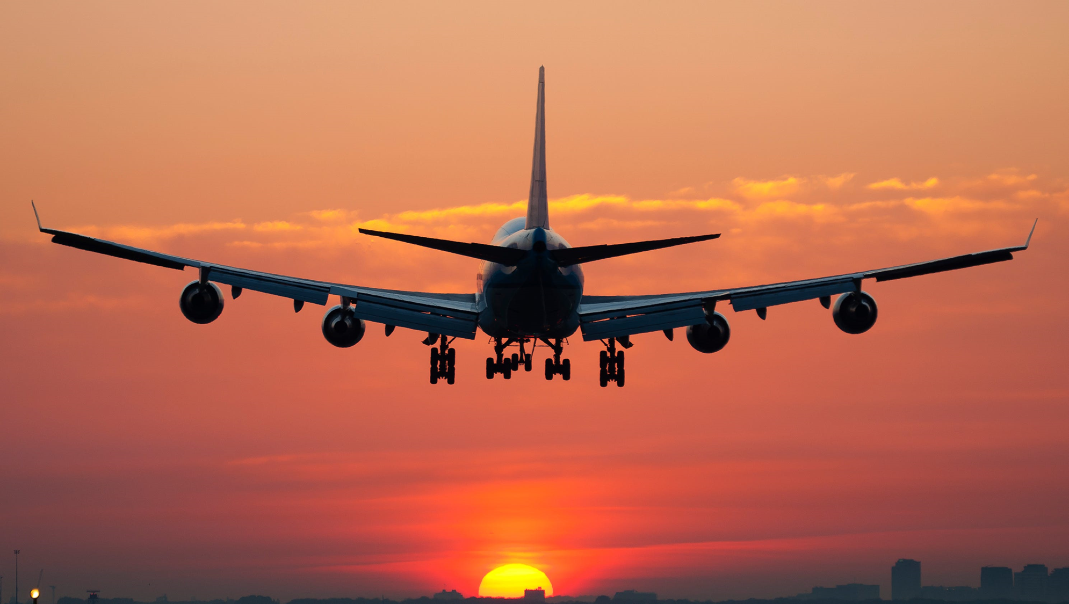
Optimizing Flight Booking Decisions through Machine learning Price Predictions INDRODUCTION:

Slide 3
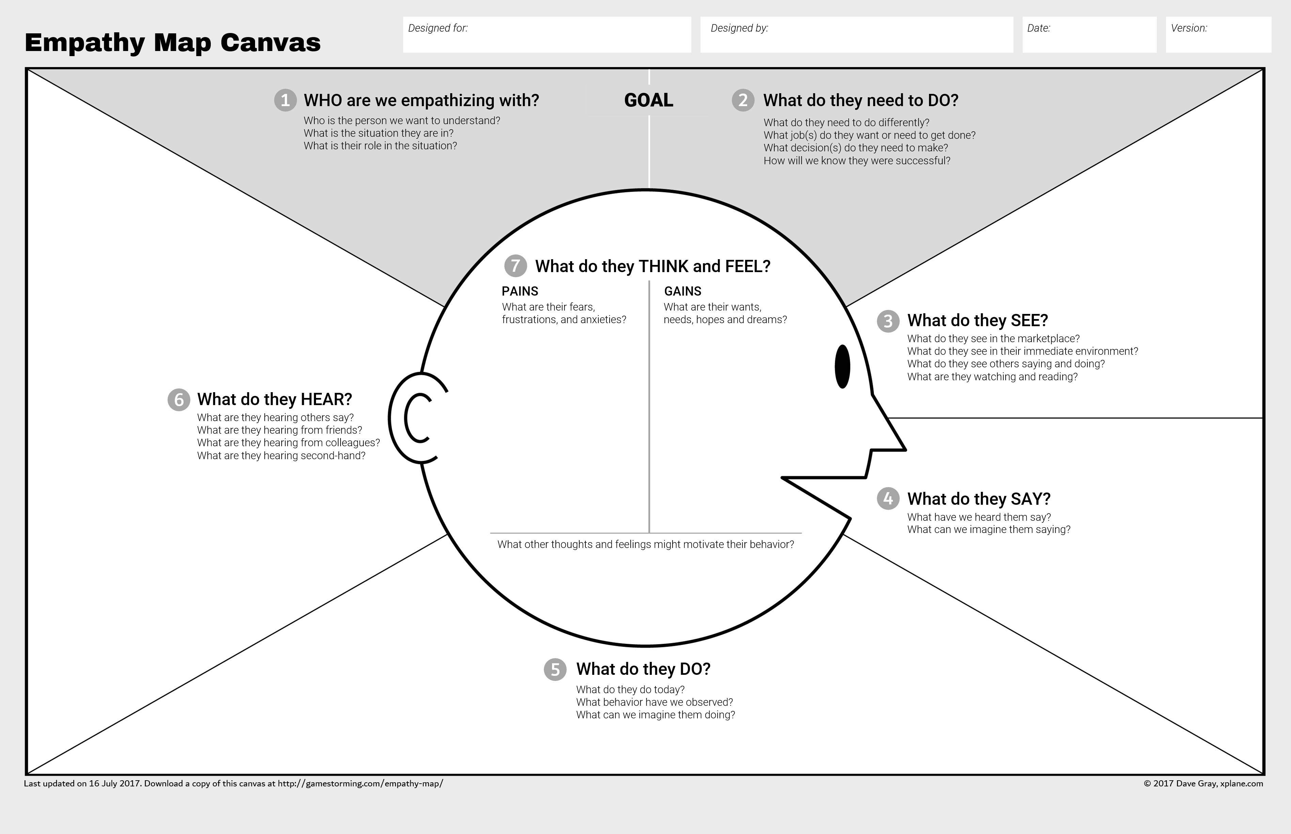
Empathy Map : we explain in the empathy map, how the customer will think ,says feels and does about the project like this,

Slide 4
DATA PREPARATION 1.DATA USED Data was used from Kaggle which is a freely available platform for data scientists and machine learning enthusiasts. 2.DATA PREPARATION Before starting data preparation let is have a glimpse of data first. Dataframe . head() 3. DATA ANALYSIS The procedure of extracting information from given raw data is called data analysis.

Slide 5
Advantages &Disadvantages of optimizing flight booking decisions through machine learning price predictions ADVANTAGES: 1. The prediction will help a traveller to decide a specific airline as per his/her budget. 2. Airline corporations are using complex strategies and methods to assign airfare prices in a dynamic fashion . 3. Due to the high complexity of the pricing models applied by the airlines. 4.User can login with valid credentials in order to access the application. 5.A traveller can access this module to get the future price prediction of individual airlines.

Slide 6
Advantages &Disadvantages of optimizing flight booking decisions through machine learning price predictions DISADVANTAGES: 1.Improper data will result in incorrect fare predictions . 2.It need active internet connection. 3.It is based on historical data. 4.Flight price prediction apps are not suitable for business travel. 5.Result has shown LightGBM regressor outperforms other conventional regressors with extensive experiment on a large real world dataset. 6.Flight delays only irritate air passengers and disrupt their schedules.

Slide 7
4. MACHINE LEARNING TECHNIQUES Various conventional machine learning algorithms are used for creating a model for flight fare prediction which is ANN, LR, DT and RF. These loads of machine learning techniques are executed using the sci-kit-learn library available in python. WE GET BENIFITS FORM THIS DEWELOPMENT & BUSINESS INPACT We are learned through the flight price prediction project is savings of time by using this method. When we try to use this machine learning it will solve our problem. We can known flight broadcasting time through the this app if any delay is ha[pend in the flight broadcasting we get the correct information in this app.

